Slide 1
Lecture 14
Deep Learning II
Recurrent Networks

Slide 2
Recurrent Networks
Y
Y(t)
Y
Y(t)
Output
Layer
Output
Layer
Hidden
Layer
Hidden
Layer
X
X(t)
X
X(t)
Feed-Forward Networks
Recurrent Networks

Slide 3
Recurrent networks are good at remembering recent context to generate outputs:
Output
Layer
This is useful when the output to be produced depends not just on the current input but also past inputs.
The hidden layer of the network builds up a representation of input history, and the output is generated from that.
h(t)
Hidden
Layer
x(t)

Slide 4
Recurrent Network Applications
Sequence recognition
Identify a word from its audio recording.
Recognize a song from its audio.
Sequence labeling
Label all proper nouns in a text.
Label all R-peaks in an ECG
Sequence/Time-Series Prediction
Predict the price of a stock based on previous prices.
Predict the next word in a text given the words so far (Language models).
Sequence Generation
Generate a sequence of actions to perform a task.
Play a piece of music given its title.

Slide 5
Sequence-to-Sequence Learning
Output a sequence in response to an input sequence.
Output the words of a song given the lyrics.
Machine translation.
Language Representation
Embed sentences into a vector space (sentence embedding).
Associative Memory
Store and recall associative memories as attractors.
Pattern Completion
Complete/filter a pattern given a noisy or partial version.
….. And many others.

Slide 6
Why are recurrent networks “deep”?
Y(t)
Y(1)
Y(2)
Y(3)
=
X(t)
X(1)
X(2)
X(3)

Slide 7
Why are recurrent networks “deep”?
Y(3)
Y(1)
Y(2)
Y(3)
Y(2)
=
X(3)
Y(1)
X(1)
X(2)
X(3)
X(2)
Each cycle of time is like going through a layer of neurons
Recurrent networks learn using backpropagation through time (BPTT)
X(1)

Slide 8
Training Recurrent Networks
A typical, single hidden-layer recurrent network.
Weight vector:
W ^{oh}
h(t)
W^{hh}
Loss function: J(t)
Data set: { (x(t), y(t))}
Training/validation/test sets
W^{hi}
x(t)
Typically, several shorter sub-sequences are grouped into a minibatch, and several minibatches in an epoch.
Recurrent networks are trained by backpropagation.
Each time-step adds a layer to the effective network.
Backpropagation of δs through layers = propagation of δs back through time.
Backpropagation Through Time (BPTT)

Slide 9
Learning Procedure:
For t = 1 to T
- Present input x(t)
- Get the output
- Compare with desired output y(t) to get errors e(t) and loss J(t)
- Calculate the gradient
- Calculate change in weights using
- Update weights or accumulate change update at end of sequence/minibatch/epoch
End
Main Issue:
Hidden output h (t) depends not just on x(t) but also on h (t-1)
And h (t-1) is generated through the same weights as h (t)
And the same is true for h (t-2) and h (t-3) ,…., h (1)
So h (t) at time t depends on the recurrent weights W^{hh} through multiple paths.

Slide 10
To train the W^{hi} and W^{hh} weights, we need to calculate:
W ^{oh}
h(t)
W^{hh}
W^{hi}
x(t)

Slide 11
To train the W^{hi} and W^{hh} weights, we need to calculate:
W ^{oh}
Multiple paths
of dependency
h(t)
W^{hh}
W^{hi}
x(t)

Slide 12
To train the W^{hi} and W^{hh} weights, we need to calculate:
W ^{oh}
Must be summed over all paths
h(t)
W^{hh}
W^{hi}
x(t)
W ^{oh}
W ^{oh}
W ^{oh}
W ^{oh}
h(1)
h(t-2)
h(t-1)
h(t)
W^{hh}
W^{hh}
W^{hh}
W^{hh}
W^{hi}
W^{hi}
W^{hi}
W^{hi}

Slide 13
To train the W^{hi} and W^{hh} weights, we need to calculate:
W ^{oh}
h(t)
W^{hh}
W^{hi}
x(t)
W ^{oh}
W ^{oh}
W ^{oh}
W ^{oh}
h(1)
h(t-2)
h(t-1)
h(t)
W^{hh}
W^{hh}
W^{hh}
W^{hh}
W^{hi}
W^{hi}
W^{hi}
W^{hi}

Slide 14
W ^{oh}
W ^{oh}
W ^{oh}
W ^{oh}
h(1)
h(t-2)
h(t-1)
h(t)
W^{hh}
W^{hh}
W^{hh}
W^{hh}
W^{hi}
W^{hi}
W^{hi}
W^{hi}
Consider the paths shown in different colors:
+
+
+
+
chain rule

Slide 15
W ^{oh}
W ^{oh}
W ^{oh}
W ^{oh}
h(1)
h(t-2)
h(t-1)
h(t)
W^{hh}
W^{hh}
W^{hh}
W^{hh}
W^{hi}
W^{hi}
W^{hi}
W^{hi}
Consider the three paths shown in different colors:
+
+
+
+
Note that this could be written as
but that would confuse it with the LHS

Slide 16
Thus, at time step t:
from which, we can calculate:
Similarly for
Problem: As t gets larger, we need to calculate longer and longer chains.
Solution: Use shorter training sub-sequences, limit how far back to chain
This is called truncated BPTT with look-back limited to τ steps back.
Problem: Back-propagating through time causes vanishing or exploding gradients.
Solution: Clip the gradient (to prevent explosion), use ReLU (to prevent vanishing).

Slide 17
ch esse gerne Äpfel
ch esse gerne Äpfel
Ich esse gerne Äpfel
Sequence-to-Sequence Learning with RNNs
Given an input sequence A = {a₁ a₂ a₃ .... a_{n}}
Generate a desired output sequence B = {b₁ b₂ b₃ … b_{m}}
where n and m are not necessarily equal.
Example: Machine Translation
A = {I love to eat apples} English
B = {Ich esse gerne Äpfel} German
Let’s consider a simple RNN that takes an input and generates an output and a hidden state
h(t)
h(t-1)
h(t)
Hidden
Layer
Output
Layer
h(t)
x(t)
x(t)

Slide 18
Encoder Stage:
outputs are ignored
h(1)
h(2)
h(5) now encodes the meaning of the whole sentence
h(3)
h(4)
h(5)
I love to eat Apples
Decoder Stage:
Ich esse gerne Äpfel <EOS>
Decoding now begins using h(5) as the coded meaning of the input sentence
h(5)
h(6)
h(7)
h(8)
h(9)
<EOS>
Ich esse gerne Äpfel

Slide 19
Decoder During Training:
Ich esse gerne Äpfel <EOS>
Correct inputs and desired outputs are provided explicitly for supervised learning
h(5)
h(6)
h(7)
h(8)
h(9)
<EOS>
Ich esse gerne Äpfel
Decoder During Inference:
Ich esse gerne Äpfel <EOS>
Each generated output is fed as input at the next time-step.
One inference error can mess up the rest.
h(5)
Representation of the input
<EOS>
Ich esse gerne Äpfel

Slide 20
Recurrent networks are good at remembering recent context to generate outputs:
Output
Layer
But how much each past input is remembered depends only on how long ago it occurred, not on its meaning or significance.
h(t)
Hidden
Layer
There is need for a recurrent network that can control which past data to remember and which to forget based on its meaning and significance.
x(t)
Long Short-Term Memory (LSTM)

Slide 21
Long Short-Term Memory (LSTM)
Hochreiter & Schmidhuber (1997) http://www.bioinf.jku.at/publications/older/2604.pdf
Cell State
C_{t-1}
×
+
C_{t}
tanh
×
×
σ
σ
tanh
σ
Hidden
State
H_{t-1}
H_{t}
Current Input
X_{t}
An LSTM Cell ↔ RNN Hidden Layer:
Each LSTM cell is a neural network with several layers shown as and
The , and denote element-wise operations.
σ
tanh
×
+
tanh

Slide 22
Comparison with Standard RNN
tanh
Hidden
State
H_{t-1}
H_{t}
Current Input
X_{t}

Slide 23
Comparison with Standard RNN
Cell State
C_{t-1}
×
+
C_{t}
tanh
×
×
σ
σ
tanh
σ
Hidden
State
H_{t-1}
H_{t}
Current Input
X_{t}
The standard hidden layer is replaced by a 4-part hidden layer, with each sub-layer of the same dimension.

Slide 24
Comparison with Standard RNN
Cell State
C_{t-1}
×
+
C_{t}
tanh
×
×
σ
σ
tanh
σ
Hidden
State
H_{t-1}
H_{t}
Current Input
X_{t}
The standard hidden layer is replaced by 4-part hidden layer, with each sub-layer of the same dimension. The green line shows the main path through the cell.

Slide 25
Long Short-Term Memory (LSTM)
C_{t-1}
×
+
C_{t}
tanh
×
×
σ
σ
tanh
σ
H_{t-1}
H_{t}
X_{t}
Squashed Net Input: The update to the cell state based on previous output state and current input transformed by a layer of tanh ( ) neurons. This is basically the hidden layer of the cell.

Slide 26
Long Short-Term Memory (LSTM)
C_{t-1}
×
+
C_{t}
tanh
×
×
σ
σ
tanh
σ
H_{t-1}
H_{t}
X_{t}
Squashed Output: The updated hidden state/output of the cell based on the new cell state squashed element-wise by a tanh ( ) function.

Slide 27
Long Short-Term Memory (LSTM)
C_{t-1}
×
+
C_{t}
tanh
×
×
σ
σ
tanh
σ
H_{t-1}
H_{t}
X_{t}
Forget Gate: Controls which elements of the cell state are remembered how much

Slide 28
Long Short-Term Memory (LSTM)
C_{t-1}
×
+
C_{t}
tanh
×
×
σ
σ
tanh
σ
H_{t-1}
H_{t}
X_{t}
Input Gate: Controls how much of each element of the squashed net input is added to the cell state.

Slide 29
Long Short-Term Memory (LSTM)
C_{t-1}
×
+
C_{t}
tanh
×
×
σ
σ
tanh
σ
H_{t-1}
H_{t}
X_{t}
Output Gate: Controls how much of each element of the squashed cell state is included in the new hidden state.

Slide 30
LSTM Equations
C_{t-1}
×
+
C_{t}
tanh
×
×
F_{t}
I_{t}
O_{t}
σ
σ
tanh
σ
W_{f}
W_{i}
W_{h}
W_{o}
H_{t-1}
H_{t}
X_{t}
⊕ = Element-wise addition
⊗ = Element-wise multiplication

Slide 31
LSTM Unfolding
H(1)
H(2)
H(3)
C(1)
C(2)
C(3)
X(1)
X(2)
X(3)
For more on LSTM…..
Tutorials:
http://colah.github.io/posts/2015-08-Understanding-LSTMs/
https://medium.com/mlreview/understanding-lstm-and-its-diagrams-37e2f46f1714
https://skymind.ai/wiki/lstm#long
https://www.analyticsvidhya.com/blog/2017/12/fundamentals-of-deep-learning-introduction-to-lstm/

Slide 32
Beyond the LSTM
The LSTM system is too complicated:
Simpler versions of gated recurrent networks have been proposed. A very commonly used one is the Gated Recurrent Unit (GRU) model
Long input sequences are still a problem:
When an output depends on a very long context (e.g., a long input sentence), LSTM and GRU still have problems learning the right dependences because they still use time-averaging – albeit weighted – to encode context into the current hidden state.
Solution: Attention – Look explicitly at not only the current hidden state but also at past hidden states, and learn which ones are important.
Attention is computationally expensive:
Keeping track of current and past hidden states explicitly makes the learning problem very large.
Solution: The transformer model – uses a CNN-style method to turn attention-based learning into a parallel rather than sequential process.
For more, see: https://towardsdatascience.com/transformers-141e32e69591

Slide 33
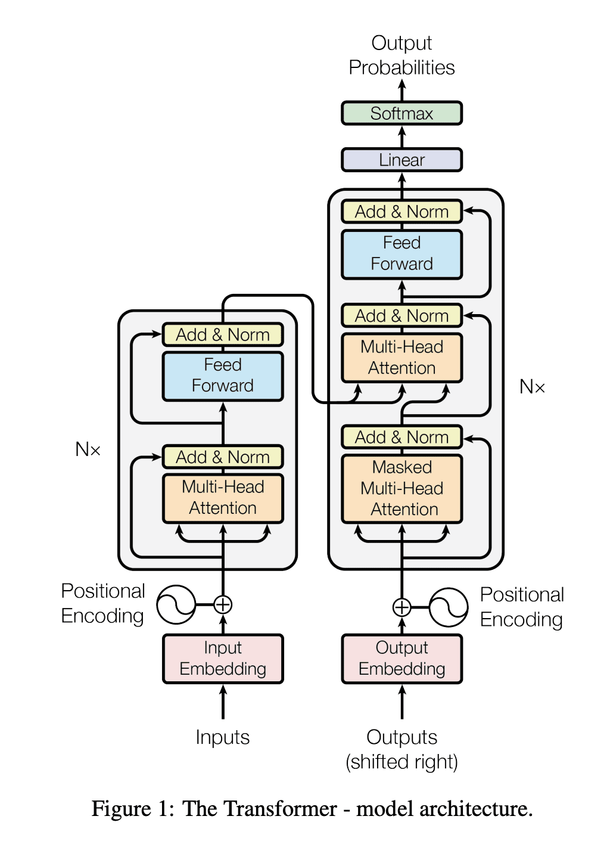
Transformer
Transformers
Transformers parallelize the processing of sequential information in an intelligent way.
Some good tutorials:
A basic introduction
A very nice, more detailed tutorial
And a really, really nice one

Slide 34
Transformer Architecture
Representing the input.
Representing the outputs already produced.
Joint input-output representation.
Output generation (classification).
Attention:
How much the processing of each term (word) should depend on the other terms.
Multi-Head Attention:
Attention weights calculated over multiple views of the terms in parallel.
Note that the blue box calculates joint attention weights for the input terms and the output terms generated so far.

